Slide 1
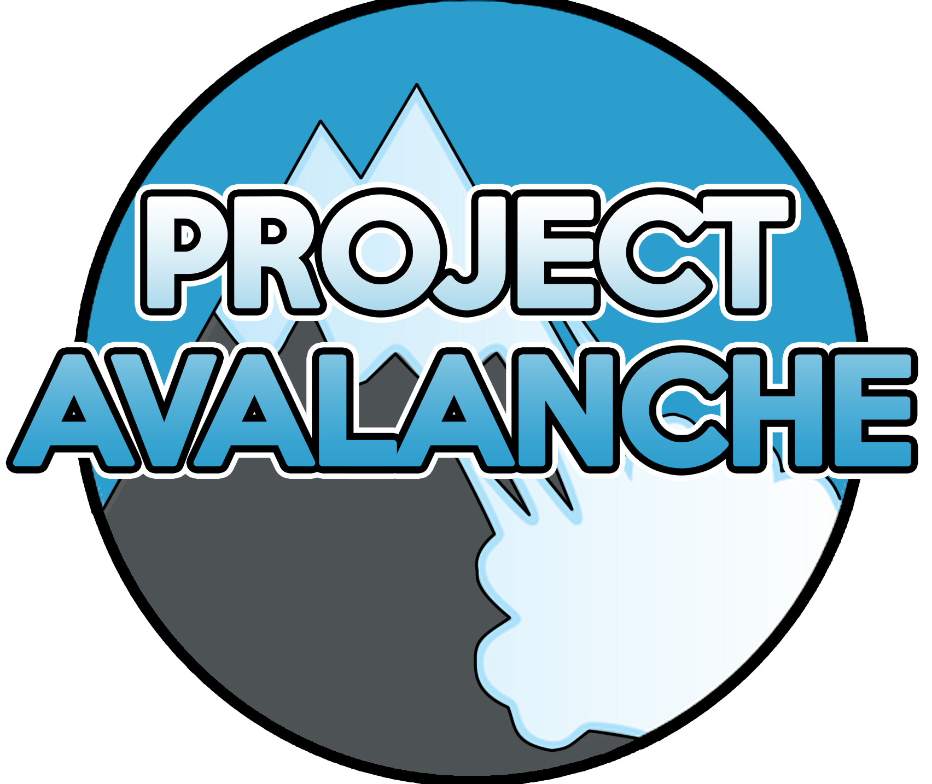
Chad Caddie, Bryce S., Saifil Ali, and Chris Folleras
Team 14

Slide 2
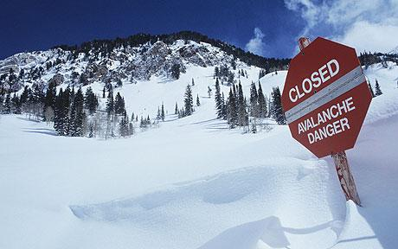

Introduction
Project Avalanche Task
Our task in this project is a continuation of the previous, an NFL game outcome predictor. The goal with this new project is creating a design which functions viably as an android application.

Slide 3
Technical Aspects
Overall Design Characteristics
The conversion of the NFL app to android included, among others, these following technical challenges:
- New, unfamiliar GUI with forms, drop-down menus, and buttons
- User touch interactions with GUI
- SPI interface mapped into an android architecture
- The translation of program calls into android activities

Slide 4
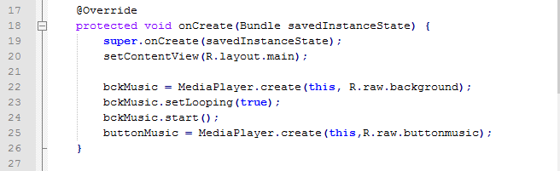
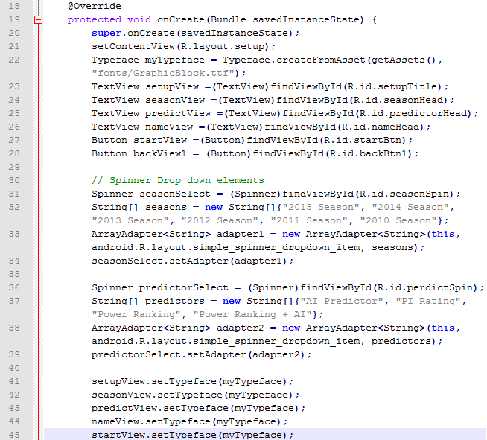
Code Snippets
Pictured are segments of code from the oncreate() method in our java main activity

Slide 5

Video of App in Action

Slide 6
Conclusions
What was expected, what happened, and what can be learned?
As expected, the challenge of learning how to work within android studio was the most difficult adaptation, but as each team member gradually familiarized themselves with the application we began to work very efficiently.
The above concept held true through each facet of the design. Our team noted: translations of each code segment followed patterns which could be identified to help in learning the overall implementation as well as specific parts.

